Slide 1
SAP BTP RAP Training
Day 19
Anubhav Oberoy
www.AnubhavTrainings.com
Follow excellence with sheer passion

Slide 2


DISCLAIMER
The training content and delivery of this presentation is confidential, and cannot be recorded, or copied and distributed to any third party, without the written consent of Anubhav Trainings

Slide 3
Agenda – Day 19
01
Extend View
02
VDM
03
Create Analytic use case

Slide 4
Extend View Concept
SAP delivers the standard views to us, we can extend these views by adding extra properties and also joins. This way we can expose the custom fields added to .APPEND include in standard tables. SAP also deliver over 9000+ standard views. Extension is always side-effect free; they never affect standard code also do not allow standard code to change.
We cannot extend a view which has parameters.
www.anubhavtrainings.com

Slide 5
VDM – Virtual data modeling
VDM is not mandatory, even if you skip VDM, your view/entities are just fine. This is a gold standard or Best Practice to create cds entities in SAP S/4HANA solution. It brings the standardization to our CDS development and increase reusability of our views.
If a colleague build cds views in a company and take holiday or leave the company, how would we know the purpose this view?
When SAP deliver standard CDS views to us, SAP do not provide the mobile number of their developers, so how you know whether you can reuse their view or not?
We need to follow common naming convention in a project as a best practice.
We need to avoid creating duplicate views for same purpose.
VDM is a technical guidance for S/4HANA CDS developers
It is represented by annotation @VDM which is kept at the top of the view
VDM classify our views in different categories as explained in next slide.
www.anubhavtrainings.com
7

Slide 6
Interface Views
VDM
Private Views
Consumption views
Basic
Composite
Starts with P_
We should never use this view to build a View on View
We should never reuse this view
Because a developer who created is trying to convey that, this view contract can change anytime
@VDM.private: true
Starts with C_
Are mainly used for final consumption in Analytic tools, or Apps
SAP deliver 100s of consumption views which become the backbone for S/4HANA embedded analytics
Consumption view is built on top of I views
We also control authorization or odata
@VDM.viewType: #CONSUMPTION
Starts with I_
They are actually used for Reuse purpose. You can freely use them in your own views.
SAP delivers standard Interface views
These views are built on top of I, P, or tables
Basic interface view is solely created using Pure master, Pure Transaction data, @VDM.viewType: #BASIC
Composite view is combination of master and transaction data
@VDM.viewType: #COMPOSITE
www.anubhavtrainings.com

Slide 7
Design process
Fiori App
SAC
S4 Embedded Analytics
APIs
Third Party
Consumption View
Consumption View
Consumption View
Composite Inf.
Composite Inf.
Basic Inf.
Basic Inf.
Basic Inf.
Basic Inf.
Basic Inf.
Basic Inf.
Private views
Private views
Table
Table
Table
Table
Table
Table
www.anubhavtrainings.com
7

Slide 8


Show the total sales per country
Total quantity sold per product
Total sales per region
I_Sales_Ana #CONSUMPTION
I_SalesCUBE #COMPOSITE
I_SalesProd #COMPOSITE
I_Sales #BASIC
P_BPA
Business part.
product
Sales order
Order items

Slide 9











































Slide 10
Joins v.s Association
A join works like a tight coupling between database objects, it always bound to happen. Which means when a join is executed, it force the read of data from multiple tables by comparing the column values. This comparison will take time inside database.
Associations are relationship between entities, they are different from joins as they do lose coupling. When we read data from cds and if cds has association, it reads the data from first table and when needed, on-demand it reads the data from second table. Especially when make mobile apps (using Fiori) associations are good for performance.
www.anubhavtrainings.com

Slide 11
Se11 DDIC views v/s CDS views
Parameters | CDS Views | DDIC Views
Code-to-data paradigm | Yes | No
Complexity | Easy | Not easy
Flexibility | More | Less
Expression language | Yes | No
Outer joins and unions | Yes | No
Type declarations | Yes | No
Analytical Adaption | Yes | No
OData Service support | Yes | No
Metadata extensions – Fiori UI | Yes | No
Built-in function | Yes | No
Parameter support | Yes | No
Ready to use system variable | Yes | No
Association | Yes | No
S/4HANA Embedded analytics | Yes | No
www.anubhavtrainings.com
7

Slide 12
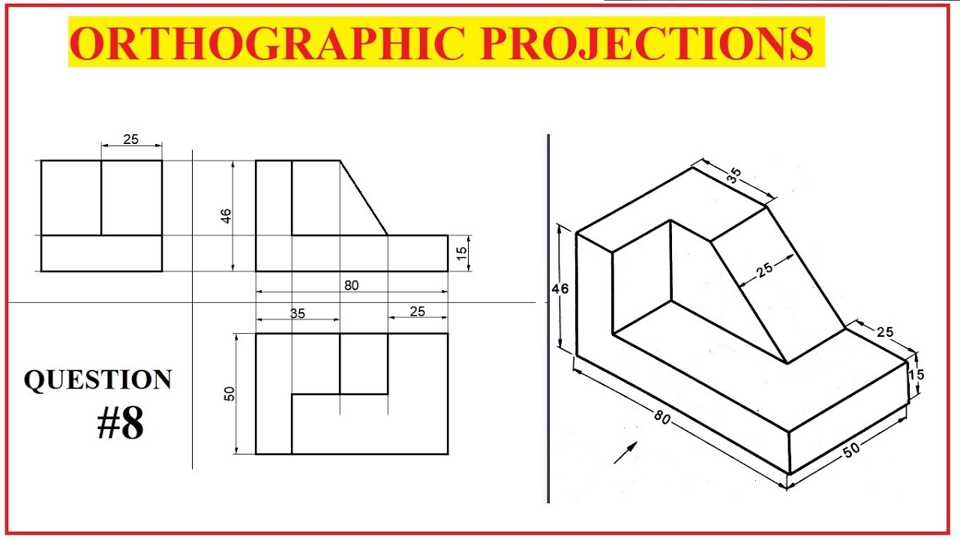
Engineering Graphics
www.anubhavtrainings.com
7

Slide 13
CDS view - projection
No special annotations
ABAP Program
@OData.publish
Fiori Application
CDS entities
@Analytics
@AnalyticDetails
Analytical Apps
@ObjectModel
Transactional App
@VDM
@Analytics
@Odata
@DefaultAggregation
Embedded analytics / SAC
@Odata
Integration API
www.anubhavtrainings.com
7

Slide 14

What We Did
Let’s Summarize

Slide 15

www.anubhavtrainings.com
Thank You
End of Day 15

Slide 16


We’re committed to empower you to be
#FutureReady
through powerful training solutions.
We build the workforce of the future.
260+
Corporate Clients
60,000+
Learners Trained
26000+
Learners Placed
FREE WEBINARS
Sign up for free webinars with industry experts every fortnight!
Enroll Now!
Contact us today!
https://anubhavtrainings.com

